Slide 1

A MONETARY SUPPLY CHAIN PLATFORM
N
A
O
T
M
E
JAZZ JAYEETA LIPI
NIMISH RIMA SANCHIT

Slide 2

The Idea
O
N
A
T
M
E
A blockchain-based application used by NGOs to keep track of the Monetary Donations.
Provide an end-to-end transparent solution where money can be easily tracked till it reaches the beneficiaries.

Slide 3
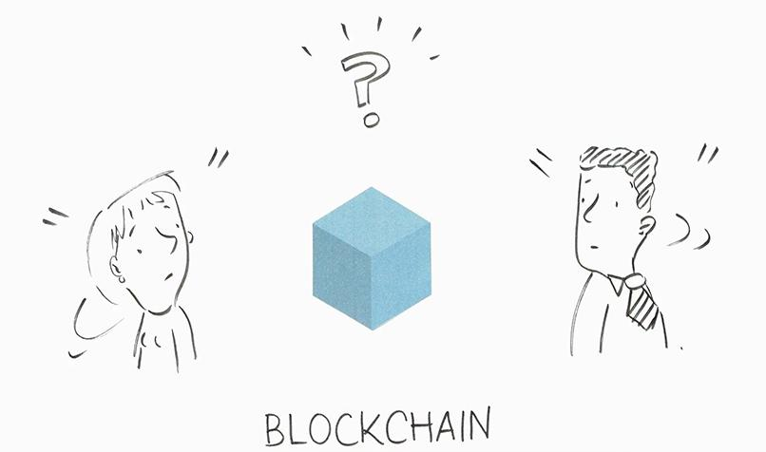
Why Blockchain?
O
N
A
T
M
E
Reduce or eliminate fraud and error
Improve efficiency
Eliminate chances of misplacements
Ensure accountability
Reduce delays and disputes
Increase the donor trust
Notes:
To reduce or eliminate fraud and error as the immutable nature of blockchain prevents tampering of the information.
Improved efficiency.
The chances of misplacements are rare, someone can be easily held responsible for by quickly tracking the transaction history.
Transparency in Blockchain will help reduce delays and disputes while preventing the money from getting stuck in the supply chain.
This in turn will increase the donor trust knowing that the money has reached where it is supposed to, by easily tracking the records.

Slide 4




Competitive Analysis
O
N
A
M
T
E
Bithope - promotes charity/ relief through cryptocurrency, not actual money.
Alice - aims to bring transparency in charity. However stops at the goal being set and achieved by charity, i.e. not the affected person verified.
Cleanwater - a new coin developed by NGOs to participate in water relief to the community.
PinkCoin - Similar to Bithope, cryptocurrency based donations model.
We aim to provide transparency in monetary charity by tracking all the way from the donor to the beneficiary.

Slide 5
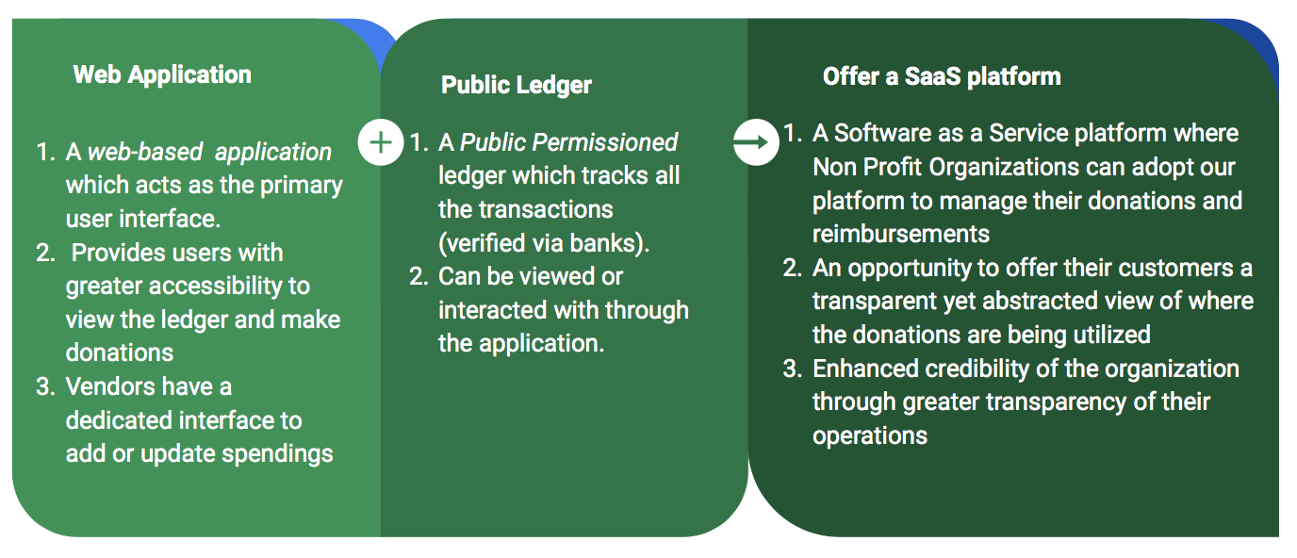
Technology Architecture
O
N
A
T
M
E

Slide 6
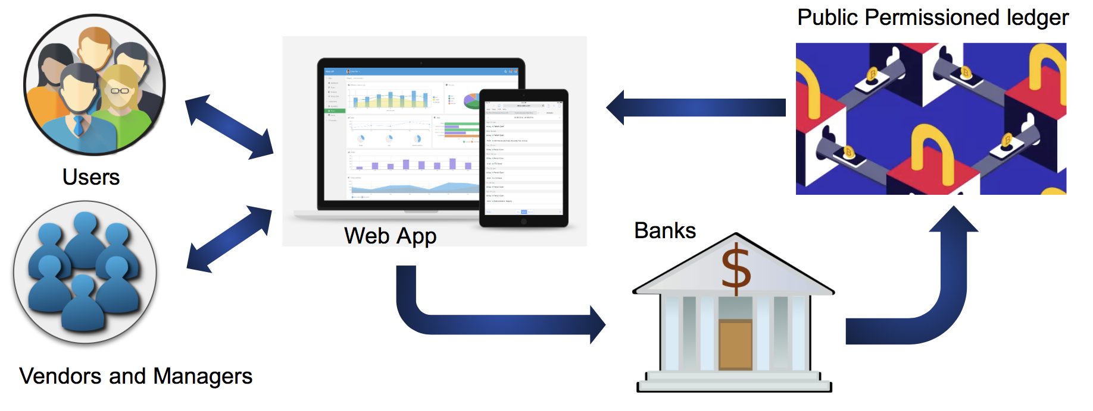
Process Flow
O
N
A
T
M
E

Slide 7
Disruption Analysis
O
N
A
T
M
E
Charities and Aid Organizations
Private companies who collect funds for Corporate Social Responsibility
Supply Chain
Government
Car Industry
Notes:
Many people want to donate to charity organizations, but worry about whether their money will actually reach the intended recipients. There is a need of an online reputation management systems that can help donors trust that their money is going to the specified people and places.
Private companies collect funds for corporate social responsibility but there is no transparency of where the funds are being used.
Supply Chain - This model can be used to track a product from its initiation to the final stage and a producer can verify it
Government - It can help the government track disbursement of funds to reduce corruption

Slide 8

Thank you

